Slide 1
Central Tendency

Slide 2
Central Tendency
In general terms, central tendency is a statistical measure that determines a single value that accurately describes the center of the distribution and represents the entire distribution of scores.
The goal of central tendency is to identify the single value that is the best representative for the entire set of data.

Slide 3
The Mean, the Median, and the Mode
It is essential that central tendency be determined by an objective and well‑defined procedure so that others will understand exactly how the "average" value was obtained and can duplicate the process.
No single procedure always produces a good, representative value. Therefore, researchers have developed three commonly used techniques for measuring central tendency: the mean, the median, and the mode.

Slide 4
The Mean
The mean is the most commonly used measure of central tendency.
Computation of the mean requires scores that are numerical values measured on an interval or ratio scale.
The mean is obtained by computing the sum, or total, for the entire set of scores, then dividing this sum by the number of scores.

Slide 5
The Mean (cont.)
Conceptually, the mean can also be defined as:
1. The mean is the amount that each individual receives when the total (ΣX) is divided equally among all N individuals.
2. The mean is the balance point of the distribution because the sum of the distances below the mean is exactly equal to the sum of the distances above the mean.

Slide 6
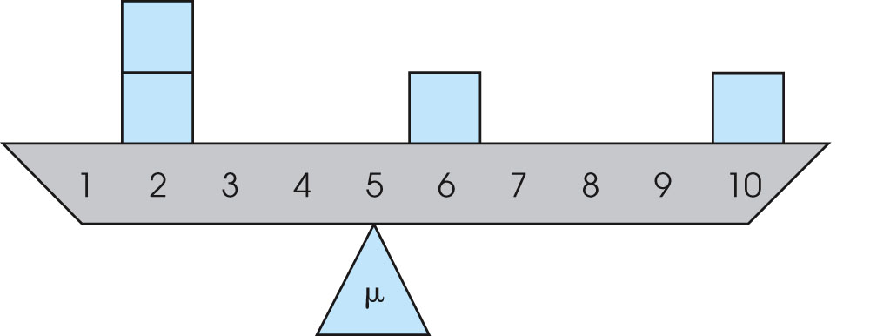
Notes:
Figure 3.3
The frequency distribution shown as a seesaw balanced at the mean.
Based on G. H. Weinberg, J. A. Schumaker, & D. Oltman (1981). Statistics: An Intuitive Approach (p. 14). Belmont, Calif.: Wadsworth.

Slide 7
Changing the Mean
Because the calculation of the mean involves every score in the distribution, changing the value of any score will change the value of the mean.
Modifying a distribution by discarding scores or by adding new scores will usually change the value of the mean.
To determine how the mean will be affected for any specific situation you must consider: 1) how the number of scores is affected, and 2) how the sum of the scores is affected.

Slide 8
Changing the Mean (cont.)
If a constant value is added to every score in a distribution, then the same constant value is added to the mean. Also, if every score is multiplied by a constant value, then the mean is also multiplied by the same constant value.

Slide 9
When the Mean Won’t Work
Although the mean is the most commonly used measure of central tendency, there are situations where the mean does not provide a good, representative value, and there are situations where you cannot compute a mean at all.
When a distribution contains a few extreme scores (or is very skewed), the mean will be pulled toward the extremes (displaced toward the tail). In this case, the mean will not provide a "central" value.

Slide 10
When the Mean Won’t Work (cont.)
With data from a nominal scale it is impossible to compute a mean, and when data are measured on an ordinal scale (ranks), it is usually inappropriate to compute a mean.
Thus, the mean does not always work as a measure of central tendency and it is necessary to have alternative procedures available.

Slide 11
The Median
If the scores in a distribution are listed in order from smallest to largest, the median is defined as the midpoint of the list.
Computation of the median requires scores that can be placed in rank order (smallest to largest) and are measured on an ordinal, interval, or ratio scale.

Slide 12
The Median (cont.)
Usually, the median can be found by a simple counting procedure:
1. With an odd number of scores, list the values in order, and the median is the middle score in the list.
2. With an even number of scores, list the values in order, and the median is half-way between the middle two scores.

Slide 13
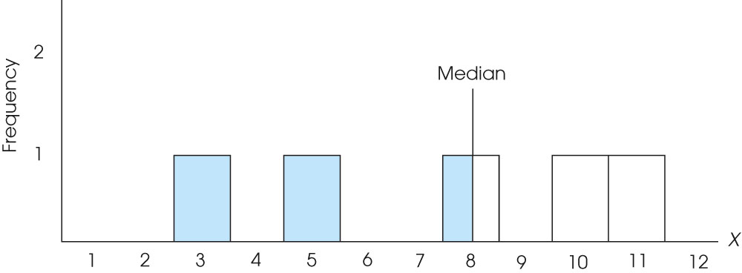
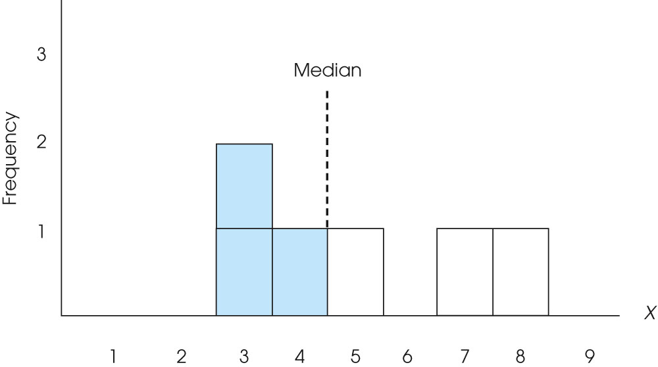
Notes:
Figure 3.5
The median divides the area in the graph exactly in half.
Figure 3.6
The median divides the area in the graph exactly in half.

Slide 14
The Median (cont.)
One advantage of the median is that it is relatively unaffected by extreme scores.
Thus, the median tends to stay in the "center" of the distribution even when there are a few extreme scores or when the distribution is very skewed. In these situations, the median serves as a good alternative to the mean.

Slide 15
The Mode
The mode is defined as the most frequently occurring category or score in the distribution.
In a frequency distribution graph, the mode is the category or score corresponding to the peak or high point of the distribution.
The mode can be determined for data measured on any scale of measurement: nominal, ordinal, interval, or ratio.

Slide 16
The Mode (cont.)
The primary value of the mode is that it is the only measure of central tendency that can be used for data measured on a nominal scale. In addition, the mode often is used as a supplemental measure of central tendency that is reported along with the mean or the median.

Slide 17
Bimodal Distributions
It is possible for a distribution to have more than one mode. Such a distribution is called bimodal. (Note that a distribution can have only one mean and only one median.)
In addition, the term "mode" is often used to describe a peak in a distribution that is not really the highest point. Thus, a distribution may have a major mode at the highest peak and a minor mode at a secondary peak in a different location.

Slide 18
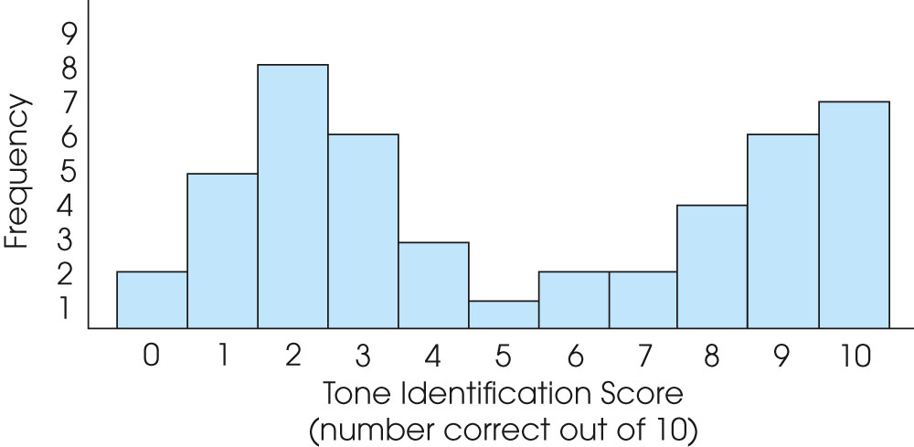
Notes:
Figure 3.9
A frequency distribution for tone identification scores. An example of a bimodal distribution.

Slide 19
Central Tendency and the Shape of the Distribution
Because the mean, the median, and the mode are all measuring central tendency, the three measures are often systematically related to each other.
In a symmetrical distribution, for example, the mean and median will always be equal.

Slide 20
Central Tendency and the Shape of the Distribution (cont.)
If a symmetrical distribution has only one mode, the mode, mean, and median will all have the same value.
In a skewed distribution, the mode will be located at the peak on one side and the mean usually will be displaced toward the tail on the other side.
The median is usually located between the mean and the mode.

Slide 21
Thank you

